Slide 1
open world program 2023 georgia
October 13-21, 2023

Slide 2
What is open world?
Funded by independent agency of Congress, the Congressional Office for International Leadership (COIL)
Brings leaders from partner Eurasian countries to the US to:
  Stay in Host homes to experience US home life
  Participate in a program related to their topic of interest through contact with US business, government, educational institutions, civic and community leaders
  Engage in discussions of timely issues and how we address them
Builds relationships
Allows delegates to “see America from the inside out”
We are the only club in our district participating in this program!

Slide 3
opportunity
October 13-21, 2023 with Georgia
Delegation of 7 (5 delegates + Facilitator + Interpreter)
Theme: Volunteerism & Civic Action
  Resocialization & rehabilitation of former prisoners
  Meet with governmental, institutional, education & community resources to learn from them. Examples:
  ~Western Technical College ~WI Department of Corrections
  ~La Crosse County Sheriff ~Mayor of La Crosse
  ~Fair Shake ~Leap for Ladies
  ~JustDane Circles of Support & Journey Home
  ~WI Crime Prevention Practitioner’s Association
  ~etc.

Slide 4
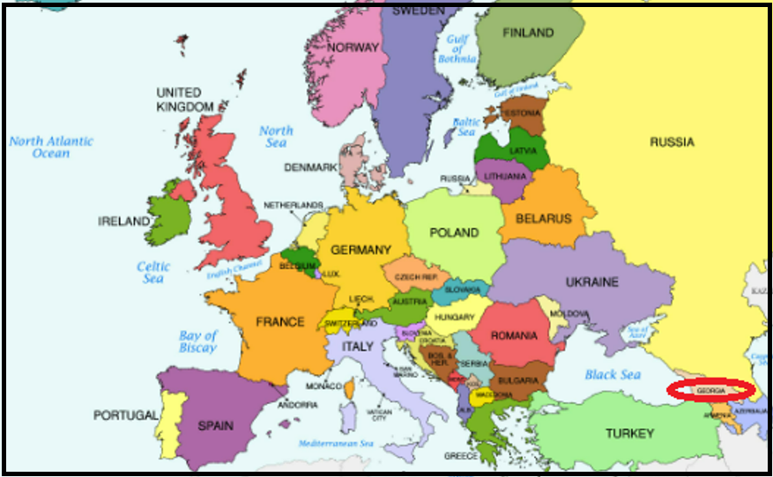
Where is Georgia?

Slide 5
INITIAL REVIEW
Received 23 documents from national office
Many components to this Program AND
Many regulations to be followed
So we quickly came to a realization……

Slide 6

To successfully complete a project like this!

Slide 7
We need your help!
We’ve broken the workload down into “chunks”
Need a Primary for each category who will:
  Master the requirements and rules for that component
  Develop the details needed
  Be the “go to” person for any questions on that piece
  Choose a Backup to share the workload & act as Primary when needed (e.g., if Primary out sick with Covid)

Slide 8
roles
Host Family Coordinator (Nancy Schmidt, Primary)
  Arrange 6 host families
  Complete forms
  Manage issues
Social Activity Coordinator
  Create schedule of activities from arrival Friday through Saturday & Sunday
  Make event arrangements/get tickets/etc.

Slide 9
roles
Transportation Coordinator (Tan Pham, Primary; Tom Byerly, Backup)
  Investigate transportation options
  Make arrangements for vehicle
  Coordinate schedule of drivers
Interpreter Coordinator
  Know rules for interpreters
  Arrange hotel room
  Handle issues

Slide 10
roles
Financial Coordinator
  Understand what is/is not reimbursable
  Use official OW system
  Manage receipts, etc.
Medical/Emergency Coordinator
  Purchase Covid test kits
  Administer tests on arrival & prior to departure
  Know protocols for handling emergencies & insurance
  Know OW harassment protocols

Slide 11
roles
Media Coordinator (Cindy Shireman, Primary)
  Handle coordination with media
  Follow OW press release guidelines
  Posts on Club website & social media
  Manage press contacts
Club Meeting Coordinator
  Obtain Rotary flags, 4-way test coins, other keepsakes
  Make any special arrangements for Club meeting & delegation presentation

Slide 12
roles
Delegate Presentation Coordinator
  Arrange for delegate presentations within interpreter guidelines (e.g., to City Council meeting, library, university, professional organizations, etc.)
Weekday Coordinators
  Work with Brad & Shari to create Monday through Friday itinerary
  Make arrangements for daily meetings, meals, etc.
  NOTE: Many organizations have already been contacted & agreed to participate, so coordinators need to work out the details.

Slide 13
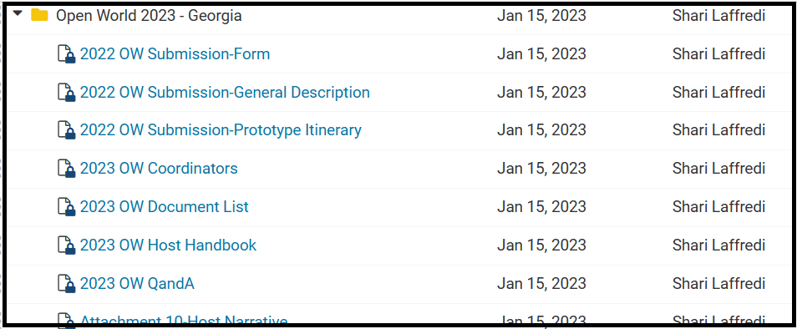
clubrunner
All OW documents have been loaded into Clubrunner
Feel free to take a look:

Slide 14
What we need now
Please take a handout and consider taking a role in this exciting project!
Brad & I are happy to answer any questions
GOAL: Identify all volunteers by February 1
More detailed one-on-ones will be scheduled with volunteers on their specific topics

Slide 15

  Please join us in making this project a success!

Slide 16


